Slide 1
GO Team Meeting
SOUTH ATLANTA HIGH SCHOOL
APRIL 10, 2023

Slide 2
Agenda
Call to Order
Roll Call; Establish Quorum
Action Items
  Approval of Agenda
  Approval of Previous Minutes
Discussion Items
  2023 Spring MAPS Results
  BASC -3 results
  Improvement Plan
  Needs Assessment
Information Items
  Principal’s Report
    2022-2023 Family Engagement and/or Partnership Highlights
Announcements
  Spring break – April 3rd -7th
  End of Pathway Assessments – April 10th – 21st
  End of Course Test (EOC) – April 25th -May 5th
  Jr./Sr. Prom – May 18th
  Visions/Seniors Awards Night – May 25th at Graduation at 6:00pm
Public Comment
Adjournment

Slide 3

2023 Spring
MAPS Results
Data Points to Consider
Spring Results
Fall to Spring Comparison
  Literacy
  Numeracy

Slide 4
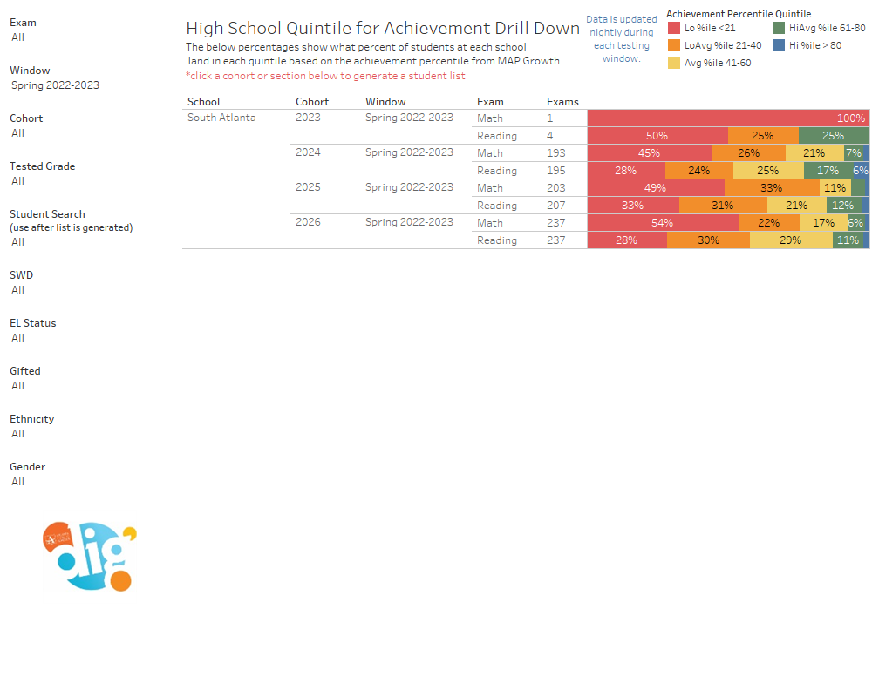

Slide 5
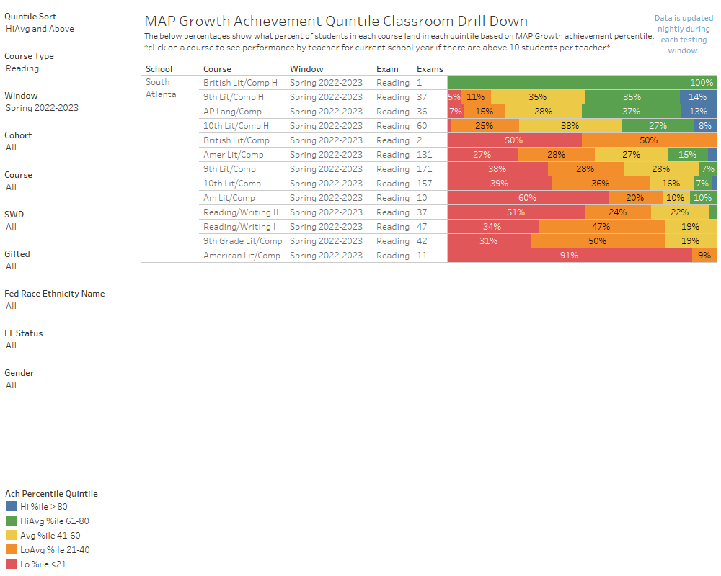

Slide 6

BASC-3 Data

Slide 7


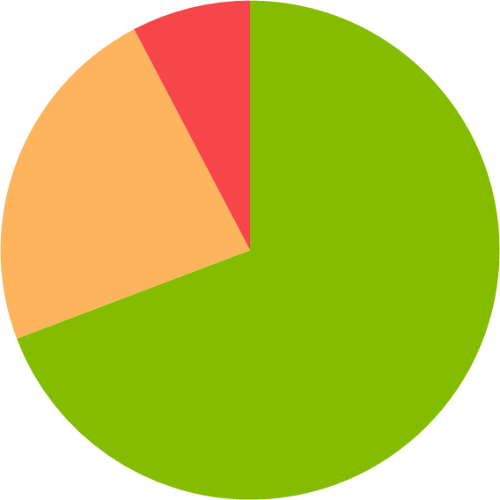


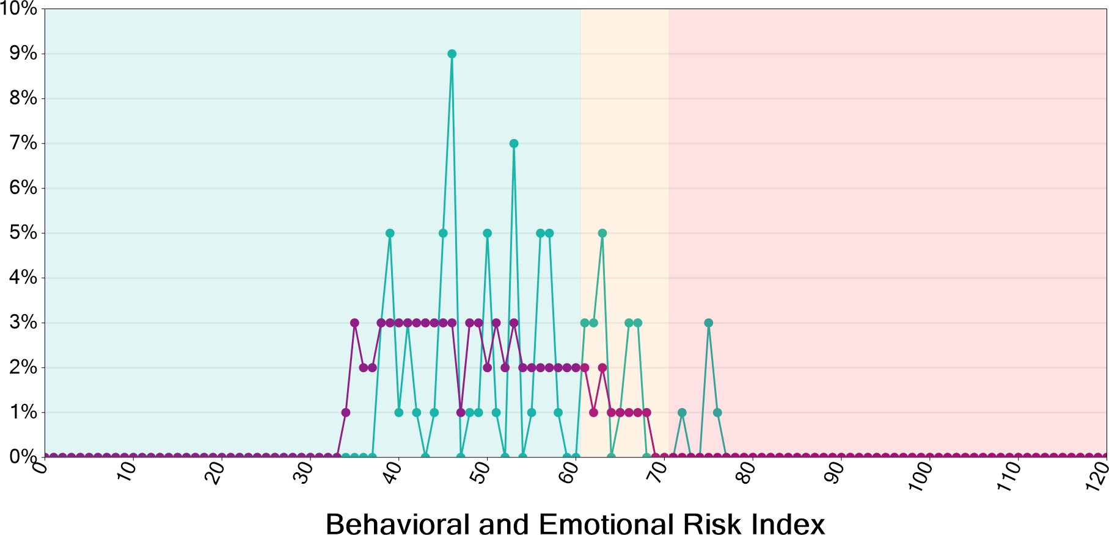
Universal Screener Summary
Spring '22 - '23 (Feb/March 2023 BASC-3 BESS)
South Atlanta High School
2/6/2023 - 3/10/2023, Behavioral and Emotional Risk Index
Behavioral and Emotional Risk Index
BESS-3 (Teacher)
₈%
Extremely Elevated Risk
4 students
District average: 7%
Elevated Risk
23%
12 students
District average: 15%
Normal Risk
69%
36 students
District average: 78%
Score Distribution

Slide 8
Risk Distribution by Grade
Grade
9th Grade | 71% | 19% | 10%
21 students | 15 | 4 | 2
10th Grade | 67% | 27% | 7%
15 students | 10 | 4 | 1
11th Grade | 75% | 0% | 25%
4 students | 3 | 0 | 1
12th Grade | 67% | 33% | 0%
12 students | 8 | 4 | 0
Risk Distribution by Gender
Gender
Female | 88% | 6% | 6%
32 students | 28 | 2 | 2
Male | 40% | 50% | 10%
20 students | 8 | 10 | 2
Risk Distribution by Ethnicity
Ethnicity
All Students
Black or African American | 68% | 22% | 10%
40 students | 27 | 9 | 4
Hispanic/Latino | 75% | 25% | 0%
12 students | 9 | 3 | 0
Female
Black or African American Female | 85% | 8% | 8%
26 students | 22 | 2 | 2

Slide 9
Ethnicity
Hispanic/Latino Female | 100% | 0% | 0%
6 students | 6 | 0 | 0
 |  | Male
Black or African American Male | 36% | 50% | 14%
14 students | 5 | 7 | 2
Hispanic/Latino Male | 50% | 50% | 0%
6 students | 3 | 3 | 0
 | Risk Distribution by | Teacher
 | Teacher
 | DARKE, MONAYE | 90% |  | 5% | 5%
 | 20 students | 18 |  | 1 | 1
 | DEZELL, DANIELLE | 43% |  | 43% | 14%
 | 21 students | 9 |  | 9 | 3
 | MORNINGPARKER, RABIAH | 82% |  | 18% | 0%
 | 11 students | 9 |  | 2 | 0

Slide 10
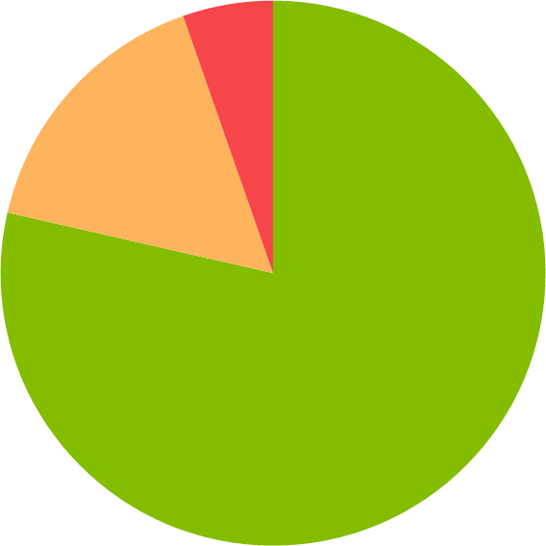
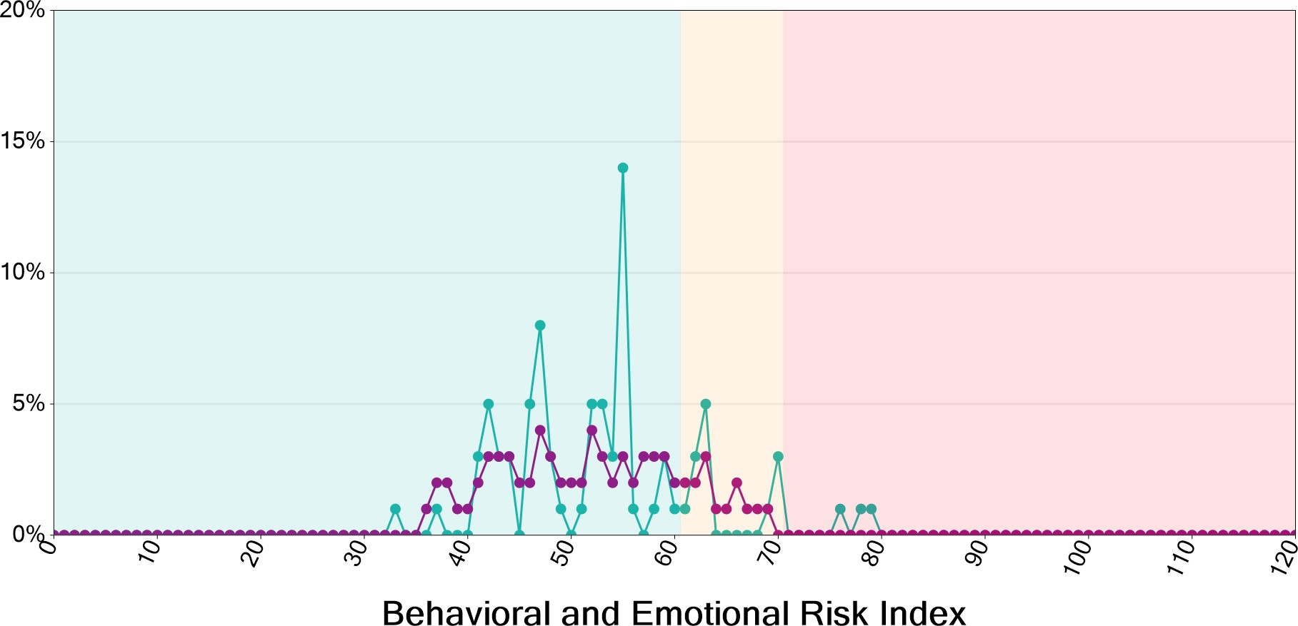
₅%
Behavioral and Emotional Risk Index
BESS-3 (Student)
Extremely Elevated Risk
3 students
District average: 6%
Elevated Risk
16%
9 students
District average: 18%
Normal Risk
79%
44 students
District average: 75%
Score Distribution
Risk Distribution by Grade
Grade
9th Grade | 100% | 0% | 0%
6 students | 6 | 0 | 0

Slide 11
Grade
10th Grade | 74% | 19% | 7%
42 students | 31 | 8 | 3
11th Grade | 100% | 0% | 0%
5 students | 5 | 0 | 0
12th Grade | 67% | 33% | 0%
3 students | 2 | 1 | 0
Risk Distribution by Gender
Gender
Female | 84% | 10% | 6%
31 students | 26 | 3 | 2
Male | 72% | 24% | 4%
25 students | 18 | 6 | 1
Risk Distribution by Ethnicity
Ethnicity
All Students
Black or African American | 80% | 14% | 6%
51 students | 41 | 7 | 3
Hispanic/Latino | 67% | 33% | 0%
3 students | 2 | 1 | 0
White | 50% | 50% | 0%
2 students | 1 | 1 | 0
Female
Black or African American Female | 83% | 10% | 7%
29 students | 24 | 3 | 2
Hispanic/Latino Female | 100% | 0% | 0%
1 students | 1 | 0 | 0

Slide 12
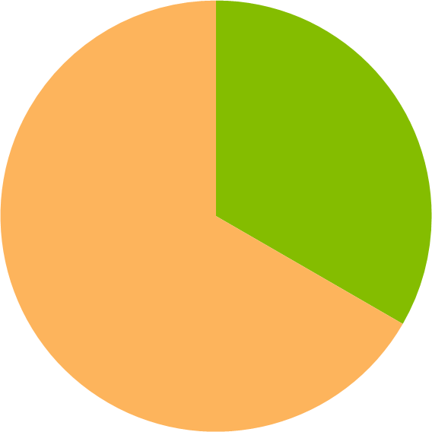
Ethnicity
White Female | 100% | 0% | 0%
1 students | 1 | 0 | 0
 |  | Male
Black or African American Male | 77% | 18% | 5%
22 students | 17 | 4 | 1
Hispanic/Latino Male | 50% | 50% | 0%
2 students | 1 | 1 | 0
White Male | 0% | 100% | 0%
1 students | 0 | 1 | 0
Risk Distribution by Teacher
Breakdown by teacher is not available for screeners completed by students or guardians.
Behavioral and Emotional Risk Index
BESS-3 (Parent)
₀%
Extremely Elevated Risk
0 students
District average: 2%
Elevated Risk
67%
2 students
District average: 7%
Normal Risk
33%
1 students
District average: 90%

Slide 13
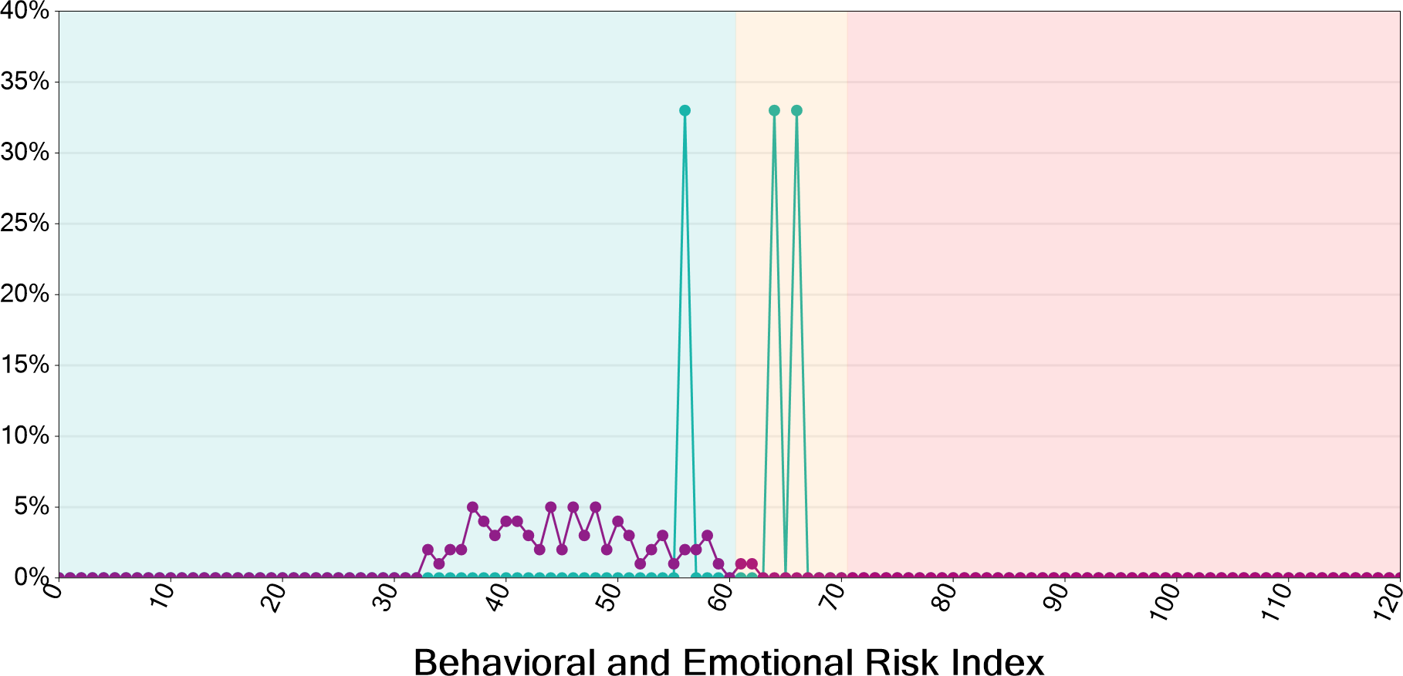
Score Distribution
Risk Distribution by Grade
Grade
9th Grade | 33% | 67% | 0%
3 students | 1 | 2 | 0
Risk Distribution by Gender
Gender
Female | 50% | 50% | 0%
2 students | 1 | 1 | 0
Male | 0% | 100% | 0%
1 students | 0 | 1 | 0

Slide 14
Risk Distribution by Ethnicity
Ethnicity
All Students
Black or African American | 0% | 100% | 0%
2 students | 0 | 2 | 0
Hispanic/Latino | 100% | 0% | 0%
1 students | 1 | 0 | 0
Female
Black or African American Female | 0% | 100% | 0%
1 students | 0 | 1 | 0
Hispanic/Latino Female | 100% | 0% | 0%
1 students | 1 | 0 | 0
 |  | Male
Black or African American Male | 0% | 100% | 0%
1 students | 0 | 1 | 0
Risk Distribution by Teacher
Breakdown by teacher is not available for screeners completed by students or guardians.
© 2023 Pearson Education, Inc.
END OF REPORT
Report generated on 4/10/2023 by KING, WANETTA

Slide 15

Needs Assessment
Needs Assessment
During this Needs Assessment, we will look at data from the Spring MAPS administration and identify 2-3 potential needs for the 2023-2024 school year.
This discussion will help school leadership as they begin developing the school’s 2023-2024 Continuous Improvement Plan this summer.
ACTIVITY

Slide 16
Needs Assessment:
Guiding Questions
What does this data tell us?
What good news is there to celebrate?
Where are growth opportunities?
What trends do we see in the data?

Slide 17
Needs Assessment:
What are two to three (2-3) needs we can identify based our data?
 | Need
1
2
3

Slide 18
Information Items

Slide 19

Principal’s Report

Slide 20
Staffing Updates
Prom 2023
Feeder School Grad Walks
Visions 2023
Coach Michael Reddick Gym Dedication

Slide 21
Additional Information Items
Cluster Advisory Team Report
GO Team Elections
  Find candidates at apsstrongschools.com
  Vote APRIL 18-27
  Households are sent a unique link based upon information in Infinite Campus
  School Staff will be sent a link to their APS email address

Slide 22

Announcements
GO Team Members
  Check your email starting May 1 for end of year survey links
    GO Team Satisfaction Survey
    Principal Feedback Survey
  Complete your required trainings ASAP
    Contact the GO Team Office with any questions

Slide 23


